Slide 1
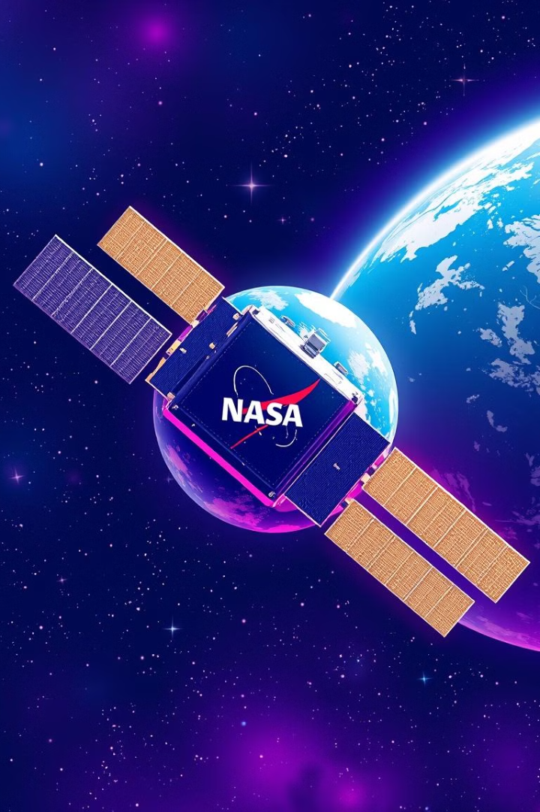
PACE Satellite: Modeling Classroom Resources
The PACE satellite, launched by NASA, gathers valuable data about Earth's oceans and atmosphere. This data can be used to enhance our understanding of the planet and its changing environment.

Slide 2

What is the PACE Satellite?
The PACE (Plankton, Aerosol, Cloud, ocean Ecosystem) mission is a NASA satellite designed to study Earth's oceans and atmosphere.
Ocean Color
Aerosols
Clouds
PACE uses spectral measurements to study the color of the ocean, which can reveal information about phytoplankton, a key component of the marine ecosystem.
PACE measures the properties of aerosols, tiny particles in the atmosphere that can affect climate and air quality.
PACE observes clouds and their properties, which play a crucial role in the Earth's energy balance.

Slide 3
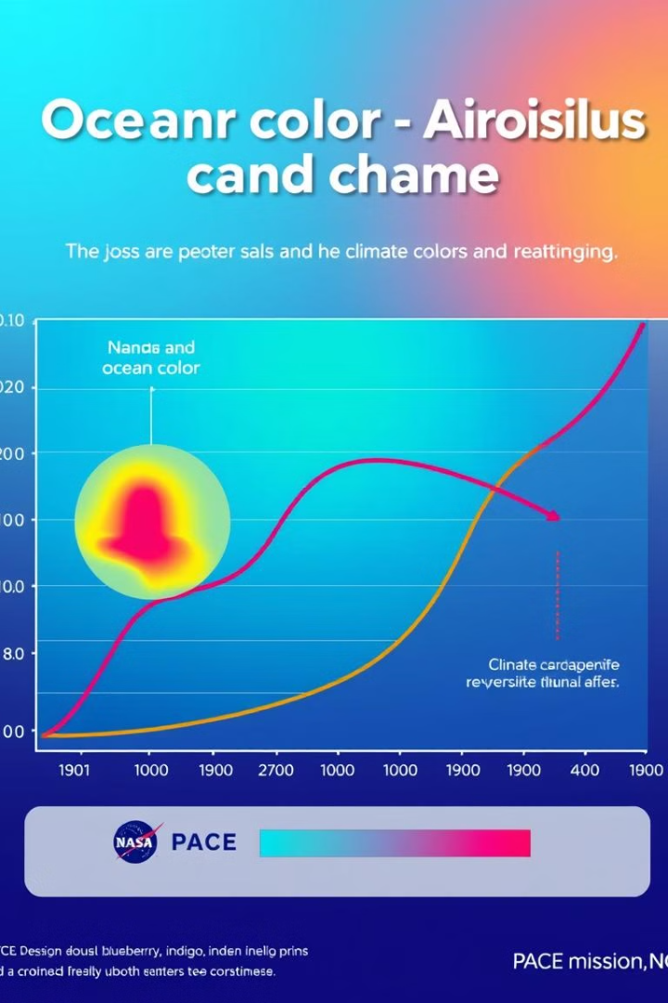
PACE Mission Objectives
PACE's primary objective is to advance our understanding of Earth's changing climate, with a focus on the oceans and atmosphere.
1
Ocean Health
2
Climate Change
PACE data will help assess the health of the ocean ecosystem and track changes in phytoplankton populations.
PACE's measurements will contribute to research on the role of the oceans and atmosphere in climate change.
3
Air Quality
PACE data will help improve our understanding of aerosols and their impact on air quality.

Slide 4
Incorporating PACE Data in the Classroom
PACE data can be used to engage students in hands-on learning activities, exploring real-world environmental science.
Data Analysis
Modeling
Climate Change Education
Students can learn to analyze PACE data to understand oceanographic and atmospheric processes.
PACE data can be used to create models of the ocean and atmosphere, helping students visualize complex systems.
PACE data can be used to teach students about climate change and its impact on the planet.

Slide 5

PACE-Aligned Lesson Plans
PACE data can be integrated into existing science curriculum, providing engaging and relevant learning experiences.
1
Ocean Color
Lesson plans can explore the relationship between ocean color and phytoplankton abundance.
2
Aerosol Effects
Students can learn about the impact of aerosols on climate and air quality.
3
Cloud Formation
Lesson plans can teach students about the process of cloud formation and its role in the climate system.

Slide 6




Hands-on PACE-Inspired Activities
Hands-on activities allow students to interact with PACE data and explore concepts in a tangible way.
Satellite Tracking
Students can track the orbit of the PACE satellite and visualize its global coverage.
Ocean Color Mapping
Students can create maps of ocean color based on PACE data, understanding the distribution of phytoplankton.
Data Visualization
Students can use software tools to visualize PACE data in different formats, creating graphs and charts.

Slide 7
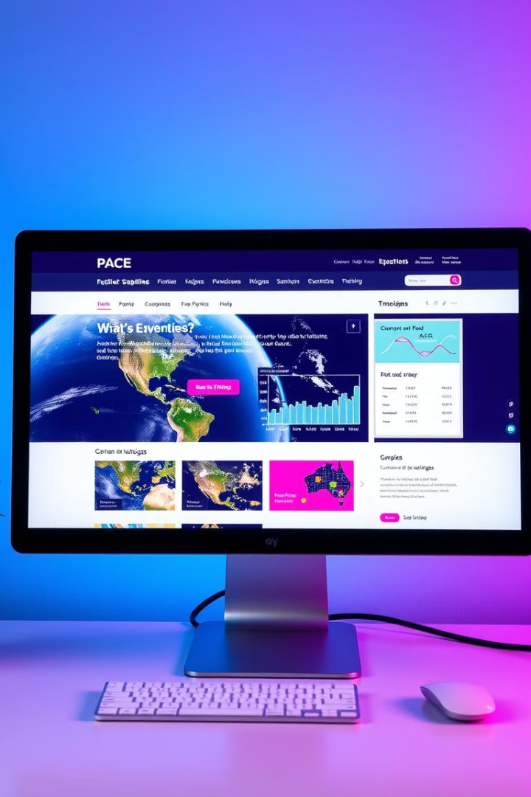
PACE Satellite Educational Resources
NASA offers a range of educational resources to help teachers incorporate PACE data into their lessons.
Website
Provides access to PACE data, lesson plans, and other educational materials.
Interactive Data Visualizations
Allows students to explore PACE data in a dynamic and interactive way.
Teacher Guides
Offers guidance on using PACE data and integrating it into existing curriculum.

Slide 8




Accessing and Utilizing PACE Data
PACE data is publicly available through NASA's EarthData website, enabling researchers and educators to access and utilize it.
Data Download
Download PACE data in various formats for analysis and research.
Data Visualization
Visualize PACE data using specialized software tools to create maps, graphs, and charts.
Global Coverage
PACE provides global coverage, allowing for comprehensive studies of Earth's oceans and atmosphere.

